Slide 1

Splint 二次开发 汇报
小组: TREE
组员:李海锋,亚航,刘恩泽

Slide 2
Summary
1 Development Model
2 Running Environment
3 Modeling
4 UI Design
5 Database Design
6 Customize Checking Rules
7 Generating Charts
8 Future Plan
Notes:
EA

Slide 3
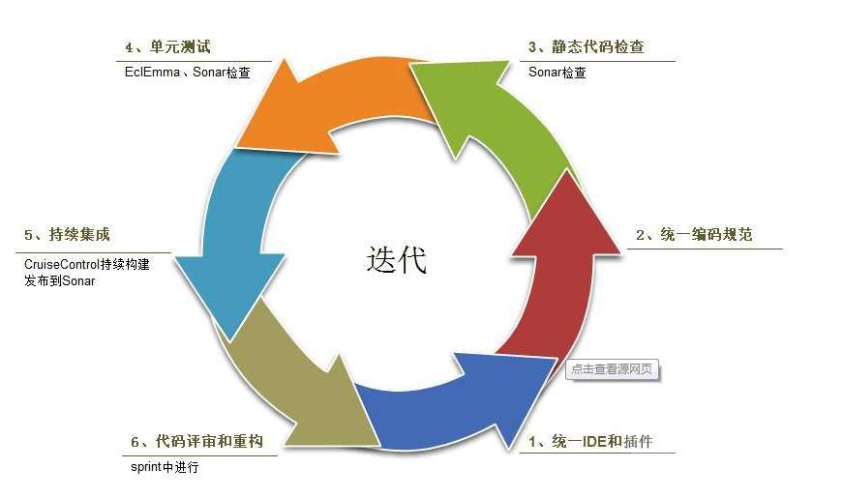
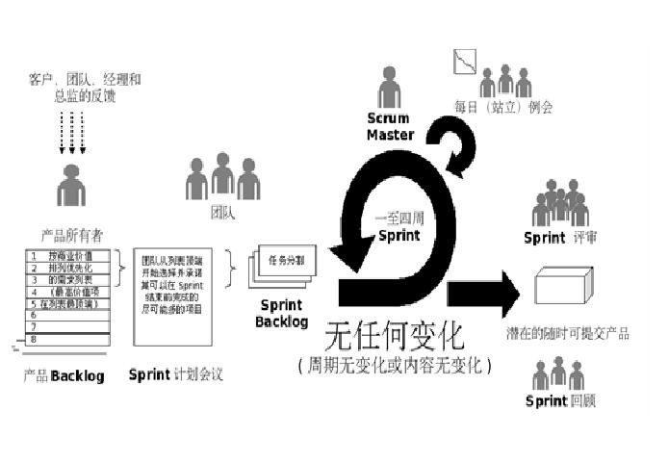
Agile Model
4 meetings a week

Slide 4
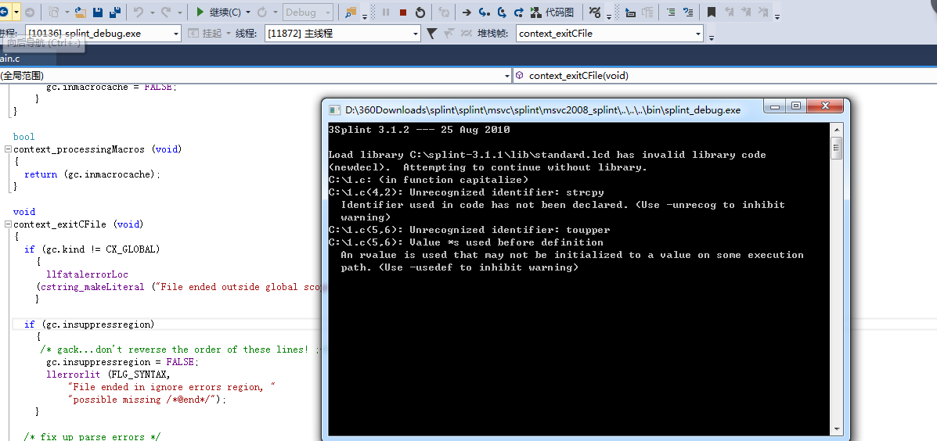
Running Environment
Running in windows

Slide 5
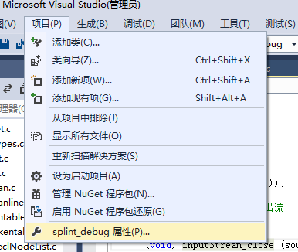
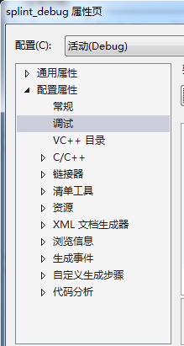

Set Parameters

Slide 6
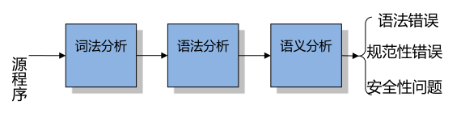
The Theory of The Software
Compared with the similar softaware：
Through lexical analysis and syntax analysis code implements the standardized examination, and then through the semantic analysis has realized the potential error code check;
As a static analysis software test tool, it can read and analyze the source program, and then read the source program which is in line with the built-in rules: by this process , the lexical analysis, syntax analysis and semantic analysis of three consecutive steps to complete.
1、Lexical analysis and syntax analysis phase is continuous, lexical analysis identify the grammatical elements in the source code,and the syntax analysis verifies the correctness of the source grammar (each syntax elements must meet certain grammatical rules;
2、Semantic analysis is a relatively independent process, this process will be for syntax analysis to get the legal elements of the semantic analysis of rationalization;

Slide 7
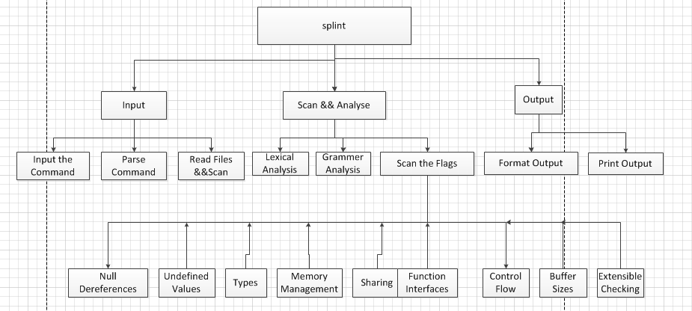
Function Models
Three Parts

Slide 8
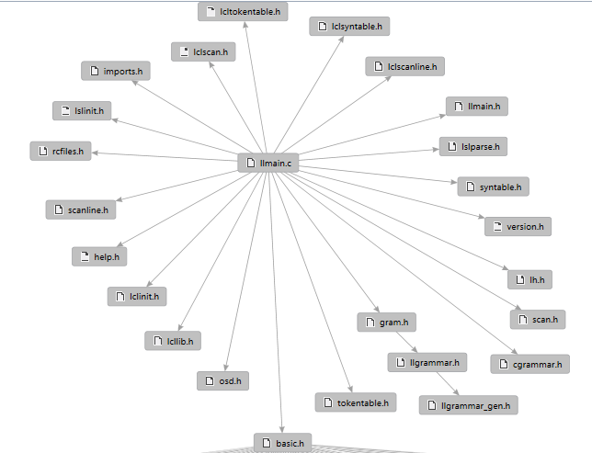
Software Analysis
The main function calls the multiple. H header file, as shown in the picture on the right;
By analyzing the llmain.c file, we found that the software is process oriented, but does not use the object-oriented without obvious features such as inheritance, polymorphism, etc;
The static security analysis method can be divided into: model test, lexical analysis, semantic analysis, etc.
Compiler has taken the basic code into a syntax tree which can more precise rules matching.
Reflection: when we write programs, we should pay attention to many points, not write a class just for the sake of "object-oriented" , but as far as possible "program to an interface", "packaging", "more combination less inheritance".

Slide 9
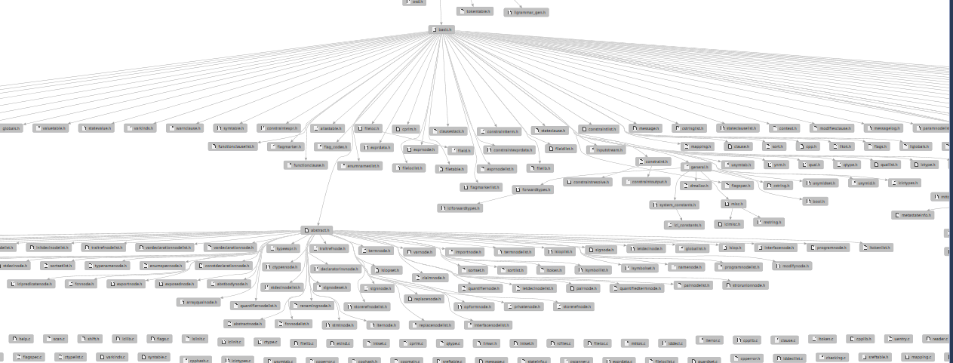
Call Relations

Slide 10
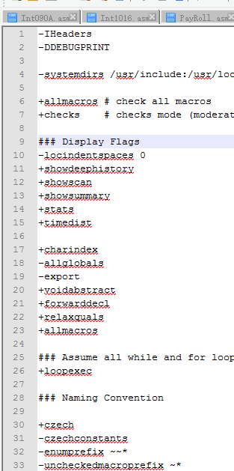
Files Analysis
A envirment file:
1 .splintrc
Every time if you don't want to use splint by manually input a heap of + / -, then you can take these '+ / -' prior written. Splintrc file, when splint perform on it will automatically add these flags. '~ / splintrc flags of the default Settings file, but once the splint in the current working directory path, if you could have .splintrc file, then this .plintrc flag sets of documents will cover' ~ / splintrc 'flags set in, but the command-line flags in the set has the highest priority, it will cover the aforementioned any flags set in a file.

Slide 11
File Analysis

Slide 12
Software Analysis
How does the result output?????
By constantly setting breakpoints,,, we found the data output stream.

Slide 13
Untill Now
Analysis section is over, then we go into the requirements and design stage~

Slide 14
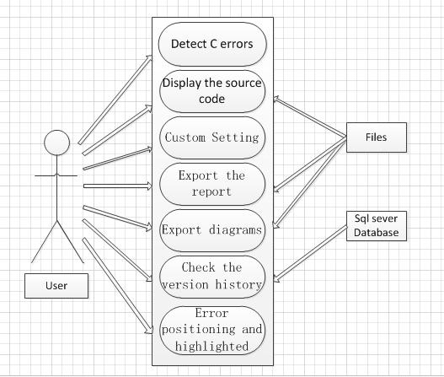
Requirement Analysis
Use Case Diagram

Slide 15
Flow Chart
Database
Input
Stream
Get
Command
Data
Output
Char
Display
Word
Dispaly
Custom
rules
library

Slide 16
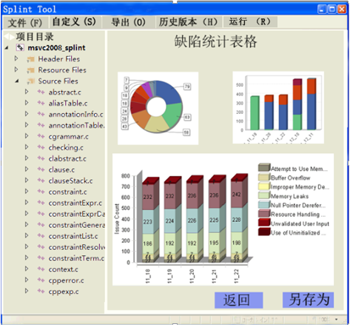
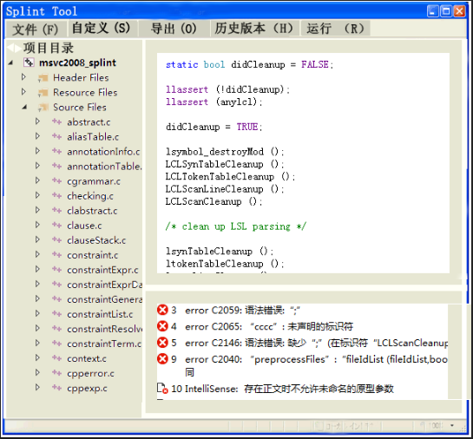
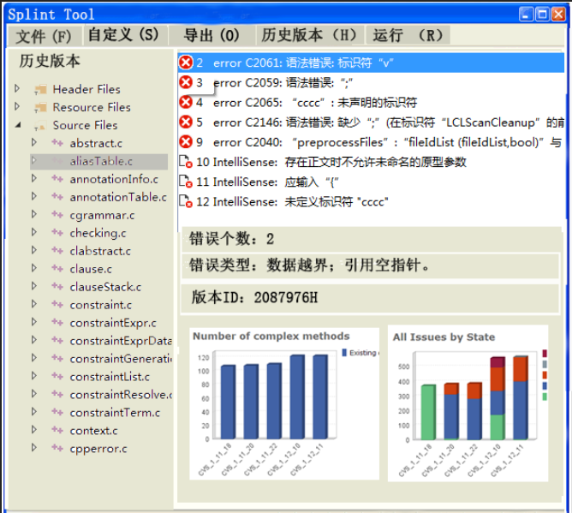
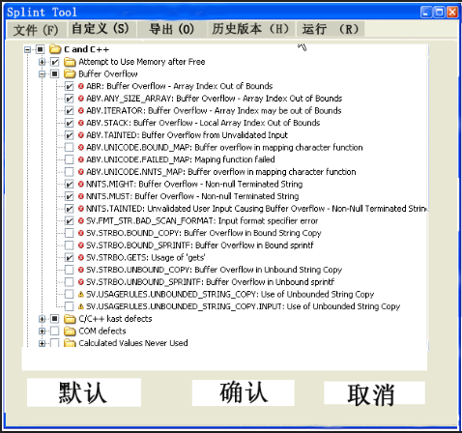
Interface Design
ps

Slide 17
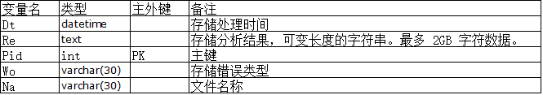
Database Design
According to the form of file storage, the user may more convenient in use when the results are stored in history version:

Slide 18
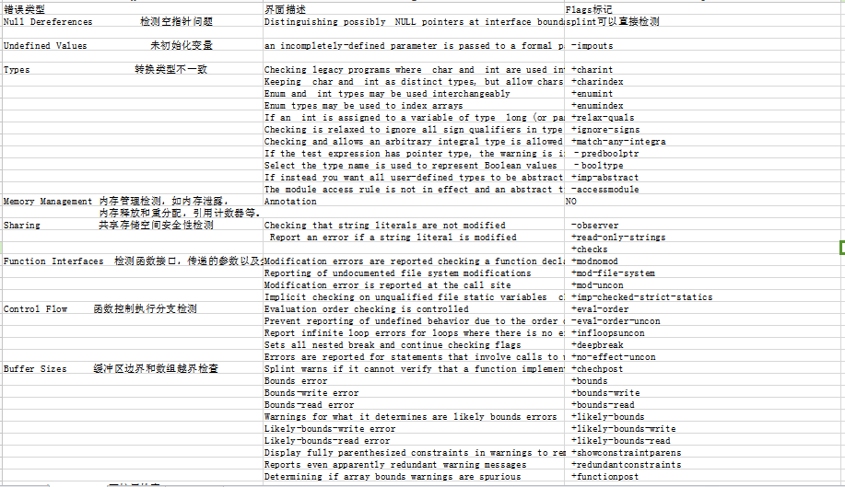
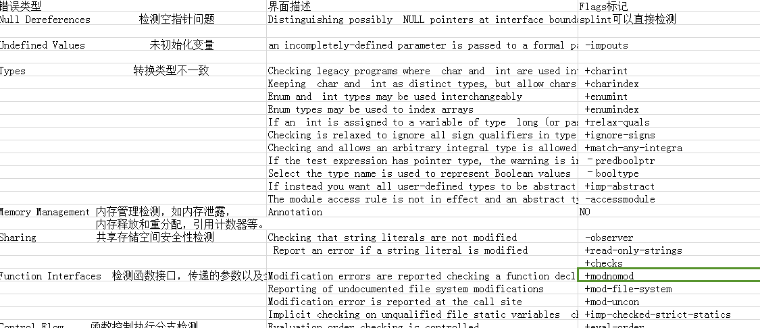
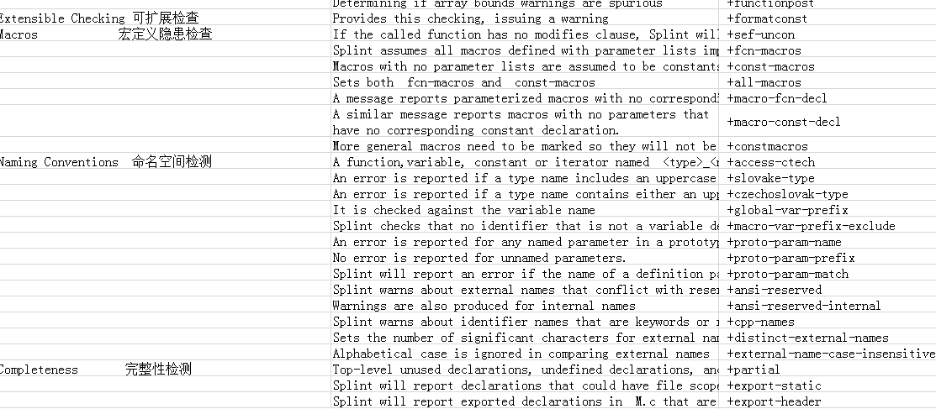
Customize
Like Klocwork, we summarize the flags in this software:
splint null.c
Null Pereferences
+impouts
Undefined Values
Flags
Types
+charint; +charindex;+anumint;relaxquals
Memory Management
Annotation
S
haring
+read-only-strings; -observer;+checks;
Function Interface
+mod-file-system;+mod-uncon
Control Flow
+eval-order;+infloopsuncon;+evalorderuncon;etc
Buffer Size
+chechpost;+bounds;+bounds-write;etc
Extensible Checking
+formatconst;sefuncon;etc
Macros
+macro-fcn-decl
Naming Conventions
+access-ctech;+slovake-type;etc
Completenes
+partial;+posixlib;etc
Libraries and Header File Inclusion
+unixlib;+ansi-strict;

Slide 19
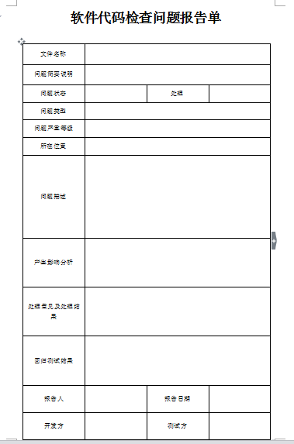
Chart Design
Using a word document to design the report

Slide 20
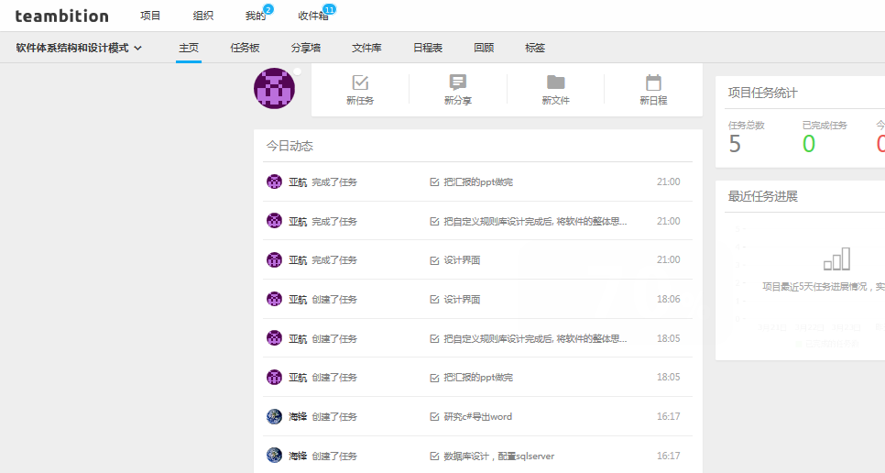
Project Management
Github
Teambition以

Slide 21
Project Management
SVN

Slide 22
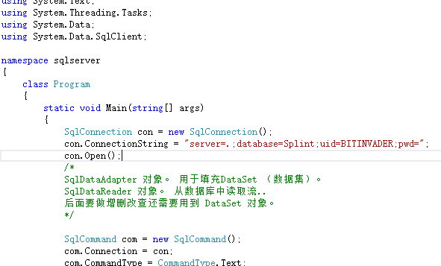
Implementation
1---Database

Slide 23
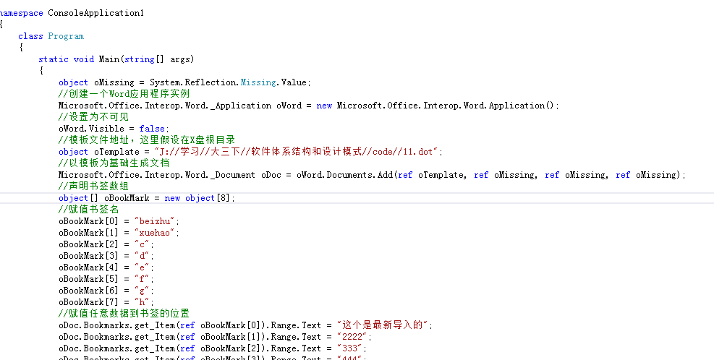
Implementation
2----Report

Slide 24
Implementation
3---Interface
——Import the project
——Display
——Testing code

Slide 25
Splint Plans
Future plans:
We have completed the basic implementation this week, tthen we go into the realization of the next stage
Week 5:
The result analysis, report generation
Weeks 6:
Custom rules library, submit final project results

Slide 26
Thanks~~~
TREE

